Slide 1
Review of Probability, Random Variables, and Engineering Distributions
Unit 4A
Fall 2022

Slide 2
References
Norman Fenton and Martin Neil, “Risk Assessment and Decision Analysis with Bayesian Networks,” CRC Press, 2nd, 2019 (RDBN, 2019)
Ebeling, C.E., Introduction to Reliability and Maintainability Engineering, 3rd ed, Waveland Press, 2019, Chapter 1, 2 (Ebeling, 2019)
Judea Pearl, The Book of Why, Basic Books, New York, 2018 (Pearl, 2018)
Modarres, M., Reliability Engineering and Risk Analysis in Engineering, Marcel Dekker, 1999 (Modarres, RERA)
Jordaan, Ian, Decisions Under Uncertainty– Probabilistic Analysis for Engineering Decisions, Cambridge University Press, 2005 (Jordaan, 2005)
Modarres, M., Risk Analysis in Engineering, Taylor&Francis, 2006 (Modarres, RAE)
Ang, A. H-S. and W.H. Tang, Probability Concepts in Engineering, 2nd ed., Wiley, 2007 (Ang & Tang, PCE)
Neapolitan, R.E., Probabilistic Methods for Bioinformatics: with an Introduction to Bayesian Networks, Morgan Kaufmann, 2009 (Neapolitan, 2009)
O’Connor, P.D.T., Practical Reliability Engineering, 4th ed, Wiley, 2002 (O’Connor, PRE)
Sivia, D.S., Data Analysis, A Bayesian Tutorial, Oxford, 1996
Rausand, M. and A. Hoyland, System Reliability Theory, 2nd ed, Wiley, 2004
Jones, P.W., and P. Smith, Stochastic Processes, an Introduction, 2nd ed, Taylor&Francis, 2010
Triola, M.F., Elementary Statistics, 10th ed., Addison Wesley, 2007 (Triola, 2007)

Slide 3
Random Events
A random (or stochastic) event or variable is one that cannot be predicted precisely due to insufficient information/understanding or insufficient control
The behavior of a random system/process can only be estimated using probability
A probability is an estimate of a random event/outcome
Probability values of 0 or 1 are interpreted as certain events (they will or will not occur), values between 0 and 1 represent intermediate ‘degree of belief’

Slide 4
Why develop models?
Modeling is highly useful to avoid numerous repetitions and to enable prediction beyond the observed events,
All engineering models make predictions that must be tested against what is observed to occur.
From periodic tests, model parameters are updated for more accurate and realistic subsequent forecasts of what is expected and therefore predicted to occur.

Slide 5
Review: Probability
Principle of Indifference (POI): All points/outcomes under the same or similar conditions are equally likely (or equally probable) to occur.
A point value estimate of P(E) = m(E)/m(S), where S, sample space, contains N ~ equally likely outcomes.
m(S) = N; m(E) = n, or n, a subset, of the N outcomes
= the size ratio of E to S or relative frequency of occurrence
In engineering applications, failures are generally not equally likely due to ranges of conditions. Also, all possible events may not be known or may not have been considered in scenario development.

Slide 6
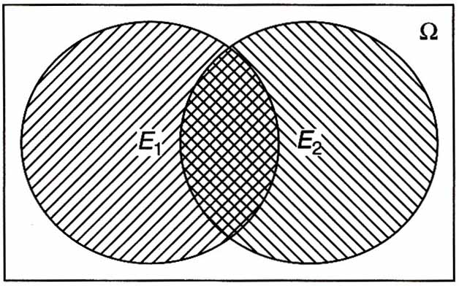
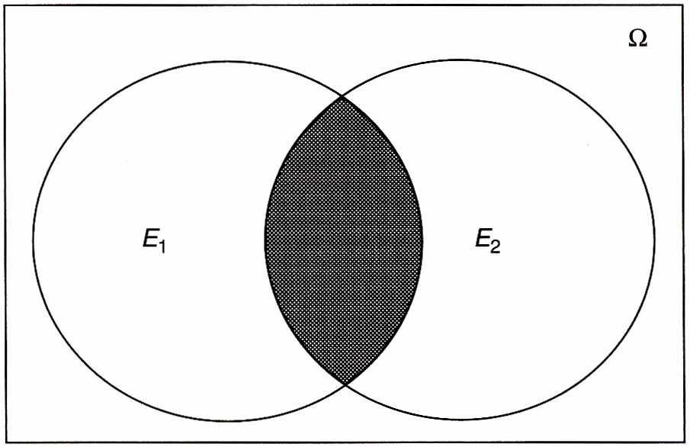
Elementary Set Theory, Venn Diagrams
Union of 2 sets, ∪:
Considers all elements in E1 and E2
Written as : E1∪E2, E1 OR E2
Called Boolean OR gate
co-occurrences in E₁ and E₂
Intersection of 2 sets, ∩:
Considers only co-occurrence of elements common to E1 and E2
Written as : E1∩E2, E1 AND E2
Called Boolean AND gate
(Modarres, RAE)

Slide 7
Union
E₁ = {x, y, z}; E₂ = {x, t, u}
E₁∩E₂ = {x} , intersection
E₁∪E₂ = {x, y, z, t, u} , union
Computation of OR, ∪, using +/–:
E₁ + E₂ = {x, y, z, x, t, u} includes x twice, because the common element x is in both E₁ and E_{2.} Compensate for overcounting by removing E₁∩E₂ to avoid over counting of common elements:
E₁∪E₂ = E₁ + E₂ – E₁∩E₂
**Rare Event Approximation: Drop small event overlap only if sum of E1+ E2 is sufficiently large.
y z x t u

Slide 8
Intersection: Example
E₁ is a set of components that operate (and may fail) within 0 to 1000 hours.
E₁ = {t | 0 < t < 1000} (uncertain t, given this range)
E₂ is a set of components that operate (and may fail) within 500 and 2000 hours.
Logic Expression: E₂ = {t | 500 < t < 2000}
Therefore, E₁ ∩ E₂ = {t | 500 < t < 1000}, or
E₁ AND E₂ both operate within 500 to 1000 hr
“given”

Slide 9
Complementary Logic Gates: Example
E₁ = {x, y, z}; E₂ = {x, t, u}
E₁ ∩ E₂ = {x}, Intersection
E₁ ∪ E₂ = {x, y, z, t, u}, Union
(E₁ ∩ E₂)^{c} = E^{c}₁ ∪ E^{c}₂ = {t, u, y, z},
Complement: outside {x}
E1
E2
y z x t u
Complement: all elements outside the common elements
The complement of the ∩ operator is the ∪ operator

Slide 10
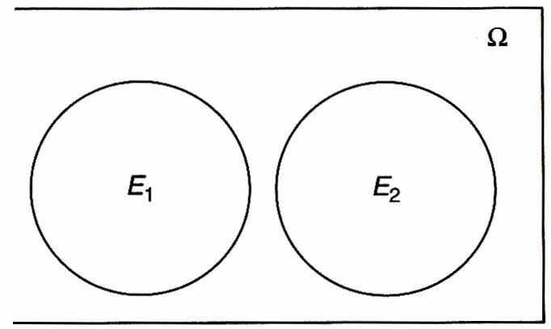
Mutually Exclusive Sets/Events
Overlap
No Overlap
Events Co-occur
Events cannot Co-occur
In both E₁ and E₂
Joint: common elements
Disjoint: no common elements
not mutually exclusive
mutually exclusive
E₁, E₂ are Independent or Dependent?
E₁, E₂ are Dependent: State Why?
(Modarres, RAE)

Slide 11
Mutually Exclusive Sets
Two sets A, B are mutually exclusive or disjoint when
A ∩ B = ∅ (null set)
No intersection with no elements common to both A and B
Example: a coin is either head or tail
A
B
P(A⋃B) = P(A) + P(B)
(Modarres, RAE)

Slide 12
Example of Mutually Exclusive
A = sum of two dice is odd
B = sum of two dice is even
So A ∩ B = ∅
A AND B are mutually exclusive or disjoint.
Dice are either up (heads) or down (tails), so consideration of both cases (up/down) is an example of 2 mutually exclusive and exhaustive (MEE) states.
Exhaustive: All cases in a sample set are included.

Slide 13
Boolean Algebra Identities
Null set
A ∩ ∅ = ∅ A ∪ ∅ = A
A ∩ A = ∅ A ∩ Ω = A
A ∪ Ω = Ω A = A
A ∪ A = A A ∩ A = A, Idempotent
Ω = ∅ Ω = ∅
Complement
Universal set

Slide 14
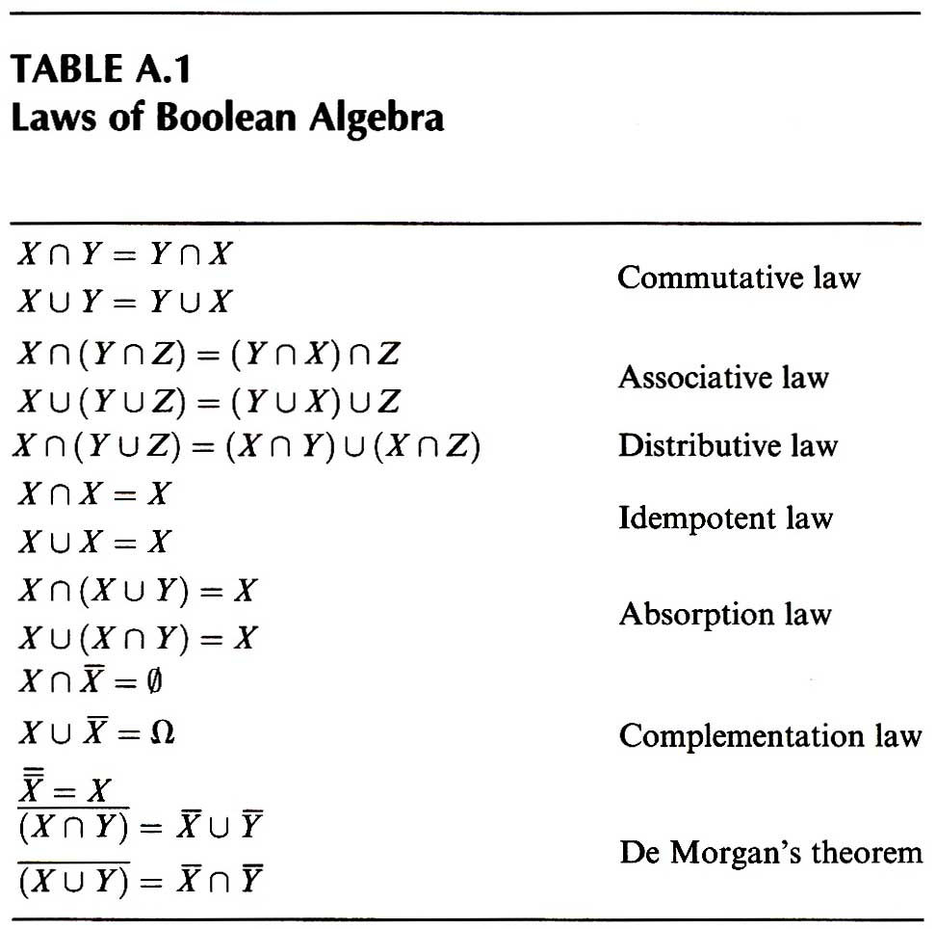
Table 2.1, p. 18, RERA
Boolean Algebra is used to evaluate sets.
Algebra
simplify

Slide 15
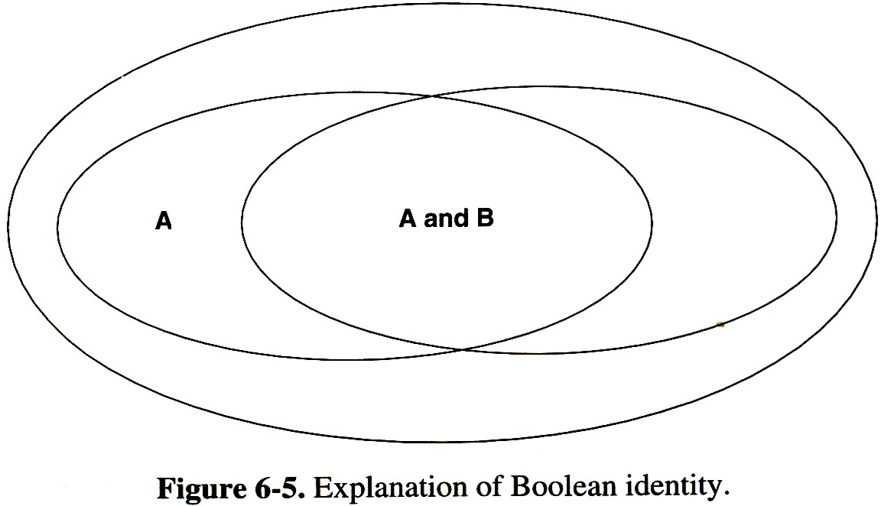
Use Absorption Law to Simplify Boolean Expressions
A ∪ (A ∩ B) = A OR (A AND B) = A
A ∩ (A ∪ B) = A AND (A OR B) = A
A ∩ B
B
Tweeddale, M, Managing Risk and Reliability of Process Plants, Gulf, 2003

Slide 16
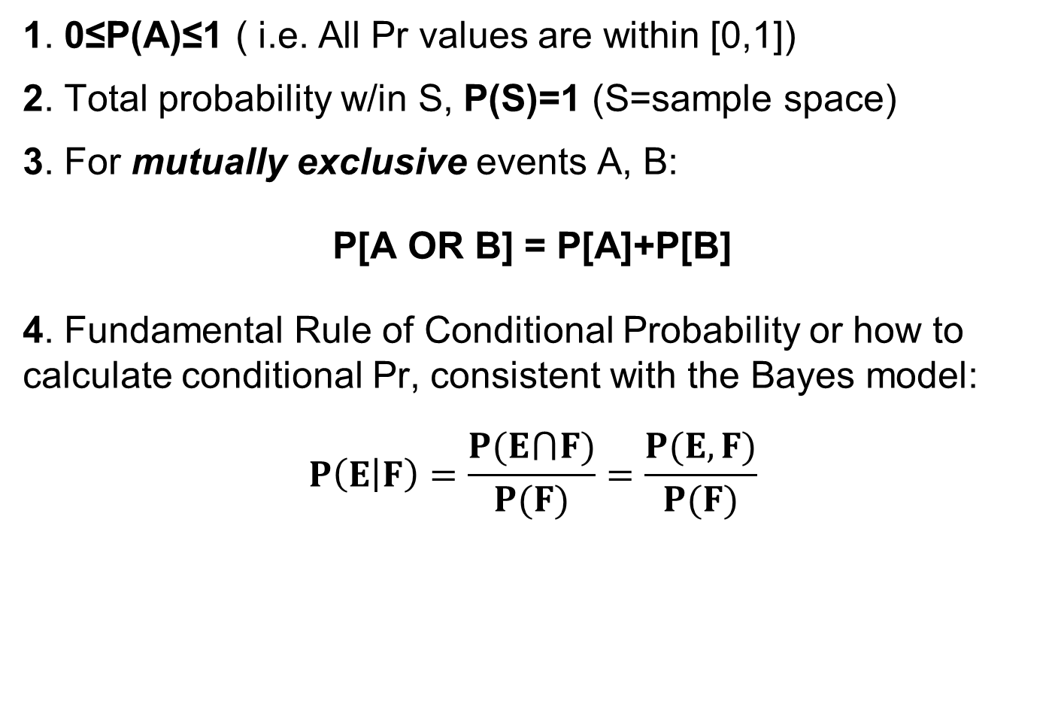
Probability Axioms
1. 0≤P(A)≤1 ( i.e. All Pr values are within [0,1])
2. Total probability w/in S, P(S)=1 (S=sample space)
3. For mutually exclusive events A, B:
P[A OR B] = P[A]+P[B]
4. Fundamental Rule of Conditional Probability or how to calculate conditional Pr, consistent with the Bayes model:
$$P\left(E | F\right)=\frac{P(E⋂F)}{P(F)}=\frac{P(E,F)}{P(F)}$$
uncertain
overlap
joint
Comma interprets that both E and F are considered true
observed
These axioms are the basis for all probability calculations.

Slide 17
Conditional Probability
Given events E and F, the conditional probability of E given F is denoted by P(E|F), where E is the uncertain event and F is the observable or known event by observation.
A definition (or Pr Axiom 4) of P(E|F) is the probability of the joint distribution, P(E⋂F) divided by the probability of F, P(F). Note that using the n/N designation, n_{EF} is the number in the discrete joint E⋂F, n_{F} is the number in F, and N is the number of events in the sample space Ω. Therefore, a point value estimate of discrete P(E|F) is the # of items in E⋂F, n_{EF}, divided by the # of items, n_{F}, in F, where due to intersection with E, the sample space of F is reduced to n_{EF}.
P(E|F) is the probability (or degree of belief) that E occurs when F is observed to co-occur.
All Pr values are conditional!

Slide 18
Conditional Probability: Intersection of Dependent A and B
If A and B are dependent, the probability that A and B occur simultaneously (or overlap) is given by:
P(A∩B) = P(A,B) = P(A|B) P(B), (A uncertain, B observed)
or equivalently,
P(A∩B) = P(A,B) = P(B|A) P(A), (B uncertain, A observed)
which are logically equivalent general expressions.

Slide 19
Conditional Probability: Intersection of Independent A and B
If A and B are independent,
P(A | B) = P(A)
Then, P(A∩B) = P(A|B)P(B) = P(A)∙P(B)
A B
A
B
Intersecting A, B can be dependent or independent.
Disjoint or ME A, B must be dependent. Otherwise A, B could intersect

Slide 20
Probability of joint and MEE events
For joint events:
P(A⋃B) = P(A) + P(B) – P(A⋂B)
P(A∩B) = P(A|B)P(B)=P(B|A)P(A)
For mutually exclusive events:
P(A⋃B) = P(A) + P(B)
P(A ∩ B)=?

Slide 21
Probability Space Example
Draw a card from a deck or 52 cards. The Queen is the set containing the 4 queens, and the King is the set containing the 4 kings. Because Queen and King are mutually exclusive sets,
P(Queen) + P(King) = 4/52 + 4/52 = 2/13
Denote by Spade the set of the 13 spades. Because the Queen, Q, and Spade, S, sets intersect (Queen of Spades) and therefore are not disjoint, their probabilities are not additive without correction.
As a result of the intersection, Q⋂S is contained both in Q and in S. Therefore, correcting Union, U, for over inclusion of Q⋂S, P(Q⋃S) = P(Q) + P(S) – P(Q⋂S) = 16/52
4/52
13/52
1/52

Slide 22
Conditional Probability Exercise
A card is drawn from a deck of 52 cards. What is the probability that the card drawn is a Jack, given I observe the card drawn is a RedRoyalCard?
Jack is the set of the 4 jacks, RedRoyalCard is the set of the 6 red royal cards (Jack, Queen, or King of Hearts and Diamonds)
Club is a set of 13 cards. Knowing a card is a club does not change the likelihood that it is a Jack of Clubs = 1/13. Therefore, these two events, Jack and Club, are independent. Also, we can demonstrate the independence directly, as shown below.
2 Jacks (Jack of Hearts & Jack of Diamonds)
(Pr Axiom 4)
(Neapolitan, 2009)

Slide 23
Law of Total Probability (LTP)
The following rule holds for conditional probabilities. Given n events, E₁, E₂, …, E_{n} such that E_{i}⋂E_{j} = ⦰ for i ≠ j, mutually exclusive, and E₁ U E₂ U …U E_{n} = Ω, (collectively) exhaustive (MEE) in the space S.
For any associated event F (in the Probability space, S), P(F⋂E_{i}) = P(F|E_{i})P(E_{i}), the E_{i} form a basis set for S.
According to Law of Total Probability (LTP):
P(F) = Σ_{i}P(F|E_{i})P(E_{i}),
(Neapolitan, 2009)

Slide 24
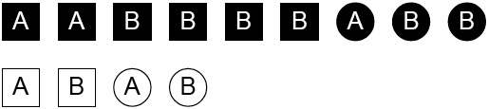
LTP: Example
For the following set of 13 objects, based on the LTP,
P(A) is dependent on Black, White
= n_{A}/N

Slide 25
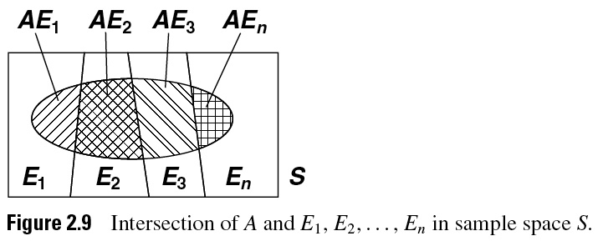
02_09
Theorem or Law of Total Probability (LTP)
|
|
|
|
A
Note how the sample space of A is reduced by the intersection of E_{i} with A, A|E_{i} as shown earlier in class exercises.
P(A) = P(A|E₁)P(E₁) +… + P(A|E_{n})P(E_{n}), where the conditioning events E_{i} are mutually exclusive and (collectively) exhaustive (MEE) in prediction of P(A).
(Ang, PCE)
Notes:
02_09.jpg

Slide 26
Probability of River Flooding, P(F)
H = heavy, P(H) = 0.2 : P(F|H) = 0.9
N = normal, P(N) = 0.5 : P(F|N) = 0.4
L = light or no, P(L) = 0.3 : P(F|L) = 0.1
Prediction of flooding the following spring by LTP:
Flooding of a river in spring depends on uncertain snow accumulation in the mountains.
Event F = uncertain occurrence of flooding
sum to 1
Snow level
All data in basis set H, N, L are
Mutually exclusive, exhaustive
Observable
Sum over all states of observable snow levels.
LTP:

Slide 27
Chain Rule for Random Variables (RV)
An important concept for RV is the Chain Rule:
For n RV, X₁, …X_{n} on the sample space Ω
Example of the chain rule: Given random variables S, H, W, for all values where S = s, H = h, and W = w. Pick one for the 1st, drop it for the 2nd, … P(s,h,w) = P(s|h,w)P(h|w)P(w) = P(w|h,s)P(h|s)P(s)
= P(h|s,w)P(s|w)P(w)
(Neapolitan, 2009)

Slide 28
Simplest Model to Represent the Evidence
Using this expansion from the Chain Rule, we can examine each of the conditional probabilities to identify the main causes or influences for the observed outcomes and develop the simplest predictive model given the evidence.
Based on data, for example, H may be observed to be only slightly affected by W or relatively independent of W, so P(h|w) can be approximated: P(h|w) ~ P(h).
So the model is simplified to P(s,h,w) = P(s|h,w)P(h)P(w)
Also, the data may show that S is relatively unaffected by W, so P(s|h,w) can be approximated by P(s|h)
So our model of main influences is P(s,h,w) = P(s|h)P(h)P(w)
If S is shown ~ independent of H, our model to approximate mutual independence of s,h,and s, is now P(s,h,w) = P(s)P(h)P(w)

